Slide 1

Product data analysis
Ali Mohammad

Slide 2
SCOPE – what to take home
Greatest hurdle and greatest learning point was importing Data – Analysis
Understanding the semantics of the Question

Slide 3
5 fundamental questions
Question 1: Which cities and countries have the highest level of transaction revenues on the site?
city | country | total
not available in demo dataset | United States | 6092.56
San Francisco | United States | 1564.32
Sunnyvale | United States | 992.23
Atlanta | United States | 854.44
Palo Alto | United States | 608
Tel Aviv-Yafo | Israel | 602
New York | United States | 530.36
Mountain View | United States | 483.36
Los Angeles | United States | 479.48
Chicago | United States | 449.52
Sydney | Australia | 358
Seattle | United States | 358
San Jose | United States | 262.38
Austin | United States | 157.78
Nashville | United States | 157
San Bruno | United States | 103.77
Toronto | Canada | 82.16
New York | Canada | 67.99
Houston | United States | 38.98
Columbus | United States | 21.99
Zurich | Switzerland | 16.99

Slide 4
5 fundamental questions
Question 2: Question 2: What is the average number of products ordered from visitors in each city and country?
The table on the right represents a random portion of the data yielded
country | city | avg_products_ordered
United States | Rexburg | 250.5
United States | Sacramento | 189
United States | Kalamazoo | 105
United States | Avon | 100
Canada | Sherbrooke | 97
United States | Nashville | 94
United Arab Emirates | Dubai | 89.2
United States | Bellingham | 62
United States | San Antonio | 58.16666667
United States | Menlo Park | 51.5
United States | Palo Alto | 48.18918919
United States | Salem | 46.18518519
United States | Boston | 40.46666667
United States | (not set) | 40.35714286
United States | Santa Clara | 36
United States | Phoenix | 32.2
United States | San Bruno | 31.75
United States | Bellflower | 30
Canada | Toronto | 25.9382716
United States | Seattle | 25.60465116
United States | Los Angeles | 24.66891892
Canada | Mississauga | 24.66666667

Slide 5
5 fundamental questions
Question 3: Is there any pattern in the types (product categories) of products ordered from visitors in each city and country?
Home office products are quite popular internationally, especially in the US
v2ProductCategory | city | country | total
Home/Nest/Nest-USA/ | Mountain View | United States | 5876
Home/Office/ | Mountain View | United States | 2826
Home/Nest/Nest-USA/ | Sunnyvale | United States | 1734
Home/Nest/Nest-USA/ | Palo Alto | United States | 1693
Home/Drinkware/ | San Francisco | United States | 1589
Home/Shop by Brand/Google/ | Mountain View | United States | 1553
Home/Nest/Nest-USA/ | San Francisco | United States | 1466
Home/Nest/Nest-USA/ | New York | United States | 1152
Home/Shop by Brand/Google/ | New York | United States | 1116
Home/Lifestyle/ | Mountain View | United States | 1039
Home/Office/ | San Francisco | United States | 931
Home/Office/ | (not set) | Taiwan | 884
Home/Electronics/ | Mountain View | United States | 784
Home/Drinkware/ | Los Angeles | United States | 729
Home/Accessories/Fun/ | Mountain View | United States | 714
Home/Shop by Brand/Google/ | Palo Alto | United States | 693
Home/Office/ | New York | United States | 686
Home/Nest/Nest-USA/ | San Jose | United States | 678
Home/Office/ | San Jose | United States | 673
Home/Drinkware/Water Bottles and Tumblers/ | Chicago | United States | 668
Home/Office/Notebooks & Journals/ | New York | United States | 668
Home/Drinkware/Water Bottles and Tumblers/ | Los Angeles | United States | 668
Home/Nest/Nest-USA/ | Seattle | United States | 618
Home/Office/ | Sunnyvale | United States | 617

Slide 6
5 fundamental questions
Question 4: What is the top-selling product from each city/country? Can we find any pattern worthy of noting in the products sold?
Per city and Country, the Nest indoor Camera was in summation the top selling product
Pattern: Stationary items such as pens, journals were popular
Security, accessories were also quite popular.
Personal items to enhance individual users
v2ProductName | city | country | total
NestÂ® Cam Indoor Security Camera - USA | Mountain View | United States | 2448
Ballpoint LED Light Pen | Mountain View | United States | 1824
NestÂ® Cam Outdoor Security Camera - USA | Mountain View | United States | 1568
Google 17oz Stainless Steel Sport Bottle | Mountain View | United States | 1336
Google 17oz Stainless Steel Sport Bottle | Los Angeles | United States | 1336
Leatherette Journal | Mountain View | United States | 1276
NestÂ® Learning Thermostat 3rd Gen-USA - Stainless Steel | Mountain View | United States | 1222
Google 17oz Stainless Steel Sport Bottle | New York | United States | 1002
Google 17oz Stainless Steel Sport Bottle | Palo Alto | United States | 1002
Android 17oz Stainless Steel Sport Bottle | San Francisco | United States | 1002
NestÂ® Cam Outdoor Security Camera - USA | Palo Alto | United States | 784
NestÂ® Cam Outdoor Security Camera - USA | San Francisco | United States | 672
NestÂ® Cam Outdoor Security Camera - USA | Sunnyvale | United States | 672
Google 17oz Stainless Steel Sport Bottle | Salem | United States | 668
Google 17oz Stainless Steel Sport Bottle | Chicago | United States | 668
Google 17oz Stainless Steel Sport Bottle | London | United Kingdom | 668
Android 17oz Stainless Steel Sport Bottle | Mountain View | United States | 668
Leatherette Journal | New York | United States | 638
NestÂ® Protect Smoke + CO White Wired Alarm-USA | Mountain View | United States | 588
Google Sunglasses | Mountain View | United States | 584
NestÂ® Learning Thermostat 3rd Gen-USA - Stainless Steel | San Francisco | United States | 564
NestÂ® Cam Outdoor Security Camera - USA | New York | United States | 560
NestÂ® Cam Indoor Security Camera - USA | Sunnyvale | United States | 510
Foam Can and Bottle Cooler | Mountain View | United States | 506
Android 17oz Stainless Steel Sport Bottle | New York | United States | 501
Ballpoint LED Light Pen | New York | United States | 456
Ballpoint LED Light Pen | Santa Clara | United States | 456
Ballpoint LED Light Pen | Palo Alto | United States | 456
Ballpoint LED Light Pen | Pune | India | 456
Ballpoint LED Light Pen | Seattle | United States | 456
Ballpoint LED Light Pen | Los Angeles | United States | 456
Ballpoint LED Light Pen | Boston | United States | 456
Ballpoint LED Light Pen | Sunnyvale | United States | 456
Ballpoint LED Light Pen | San Francisco | United States | 456

Slide 7
5 fundamental questions
Question 5: Can we summarize the impact of revenue generated from each city/country?
city | country | revenues
Chicago | United States | 306
Mountain View | United States | 61
New York | United States | 57
not available in demo dataset | United States | 396
San Francisco | United States | 72
San Jose | United States | 153
Sunnyvale | United States | 644
Tel Aviv-Yafo | Israel | 32

Slide 8
Where to explore…
To explore further questions such as time contingent factors
Diving into the psychology of the buyers

Slide 9
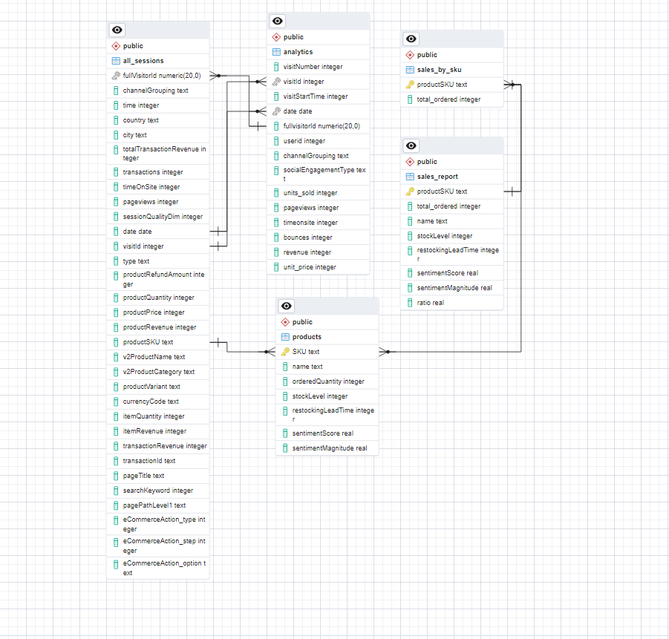
ERD Visual model

